Slide 1


The spectra-cluster toolsuite
Enhancing proteomics data analysis through spectrum clustering
Johannes Griss Medical University of Vienna EMBL-EBI

Slide 2
Clustering in proteomics data analysis
spectra-cluster algorithm
Unidentified spectrum
Spectrum identified as peptide A
Spectrum identified as peptide B
Consensus spectra
(= data reduction)

Slide 3
250 million spectra from PRIDE Archive (complete submissions)
spectra-cluster algorithm
12.6 million originally unidentified spectra identified
19 million clusters (105 million spectra) contained only unidentified spectra
Griss J., et al. (2016), Nat Meth.

Slide 4
Clustering in proteomics data analysis
spectra-cluster algorithm
Inferred identifications for label-free quantitation

Slide 5
Clustering in proteomics data analysis
spectra-cluster algorithm
Quantification of (unidentified) clusters
Characterisation of (unknown) samples
Informed pre-selection of spectra

Slide 6
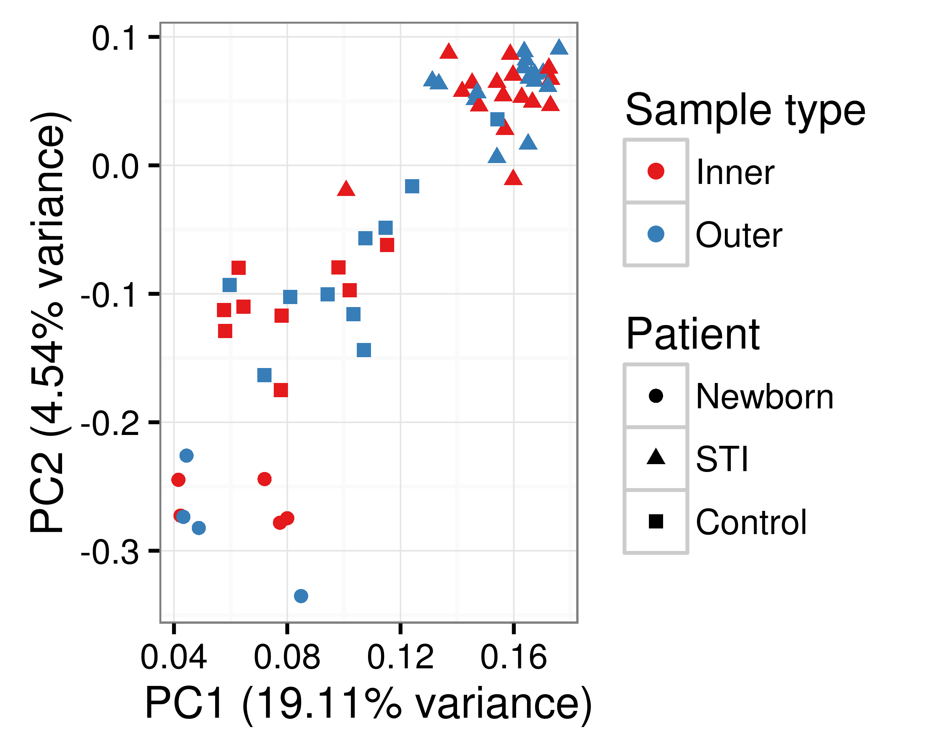
Characterisation of unknown samples

Slide 7
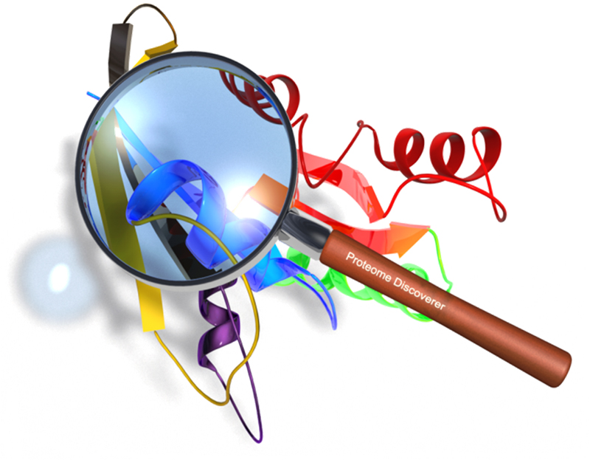




Spectra-cluster-pipeline
Clustering
Java command-line
tool + GUI
Hadoop
implementation
PD node
Analysis
Java API to
parse result files
Pyhton API +
Analysis tools
PD analysis node

